Slide 1
Lists and Tuples
Module 5

Slide 2
Module Objectives
Create and access lists in Python
Describe the various methods that are available in lists, and use them in your Python programs
Create and access tuples in Python
Identify the differences between tuples and lists
Implement the various built-in methods that are available with tuples

Slide 3
Introduction
List: Data structure that holds ordered collections of related data.
Known as arrays in other languages.
Properties:
Are ordered.
Contain objects of arbitrary types.
Elements can be accessed by index.
Are arbitrarily nestable.
Have variable sizes.
Are mutable.
Tuple: Holds together multiple related objects.
Are immutable.

Slide 4
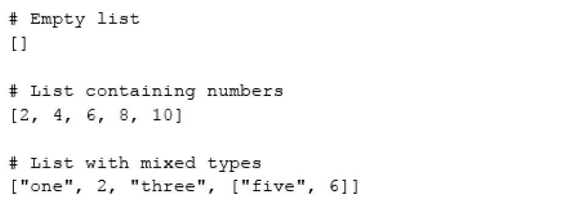
Lesson 5.1: List Syntax
Snippet 5.1

Slide 5
Lesson 5.2.1: list.append(item)
Adds single item to end of list.
Doesn’t return new list; modifies original.

Slide 6
Lesson 5.2.2: list.extend(iterable)
Extends list by appending all items in iterable to end of list.
If string is passed, each character is appended to list.

Slide 7
Lesson 5.2.3: list.insert(index, item)
Inserts item at given index.
Both arguments are required.

Slide 8
Lesson 5.2.4: list.remove(item)
Removes first item whose value matches the passed argument item.

Slide 9
Lesson 5.2.5: list.pop([index])
Removes item at given index and returns it.
Index argument is optional. If not specified, last item is removed.

Slide 10
Lesson 5.2.6: list.clear()
Removes all items from list.
Alternate: del list[:]

Slide 11
Lesson 5.2.7: list.index(item [, start [, end]])
Returns index of first item in list whose value is item.
start and end are optional; searches entire list if not provided.

Slide 12
Lesson 5.2.8: list.count(item)
Returns number of times given item occurs in list.

Slide 13
Lesson 5.2.9: list.sort(key=None, reverse=False)
Sorts list items.
key and reverse are optional.
key specifies function to be called on each item prior to comparison.
Useful if you have list of lists and want to sort on element of sublist.
reverse specifies sort order.
False sorts in ascending.
True sorts in descending.

Slide 14
Lesson 5.2.10: list.reverse()
Reverses element in list.

Slide 15
Lesson 5.3: List Comprehensions
Allows you to create list from other iterables.
Syntax consists of square brackets [] containing expression followed by for clause, then zero or more if clauses.
Example: >>> squares = [num**2 for num in range(1, 11)] >>> squares [1, 4, 9, 16, 25, 36, 49, 64, 81, 100]

Slide 16
Lesson 5.4: Tuple Syntax (1 of 2)
Advantages of tuples over lists:
Are better suited for use with different (heterogeneous) data types.
Can be used as key for dictionary.
Iterating over tuples is faster.
Are better for passing around data that you don’t want changed.
Consists of individual values separated by commas.
Create using parentheses.
Snippet 5.19 shows syntax.

Slide 17
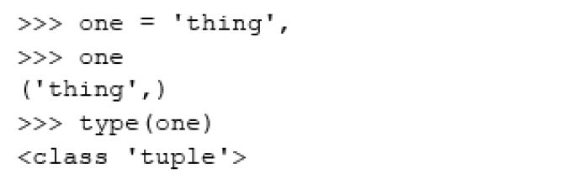
Lesson 5.4: Tuple Syntax (2 of 2)
Snippet 5.19

Slide 18
Lesson 5.5.1: Indexing
Can use index operator, [], to access element in tuple.
Indices start at zero.

Slide 19
Lesson 5.5.2: Slicing
Allows you to access subset of tuple.
General syntax: tupleToSlice[Start index (included):Stop index (excluded):Increment]
Start index:
Index at which to start slicing. If excluded, zero is default.
This element is included in slice.
Stop index:
Index at which to stop slicing.
This element is excluded in slice.
Increment:
Determines steps to take. If excluded, one is default.

Slide 20
Lesson 5.6: Tuple Methods (1 of 2)
any(tuple)
Used to discover whether any element is iterable.
Returns Boolean.
count(item)
Returns number of occurrences of item in tuple.
min(tuple)
Returns smallest element.

Slide 21
Lesson 5.6: Tuple Methods (2 of 2)
max(tuple)
Returns largest element.
len(tuple)
Returns total number of elements.
+
Used for concatenation; used in same way as lists.

Slide 22
Summary
In this module:
We expanded our knowledge on Python lists.
We have looked at the various methods that are available for lists.
We have also seen how we can use list comprehensions to make the task of building lists programmatically easier.
We covered Python tuples.
We looked at the various methods that are available for tuple operations.
We have also seen how we can access tuple elements.

